Slide 1
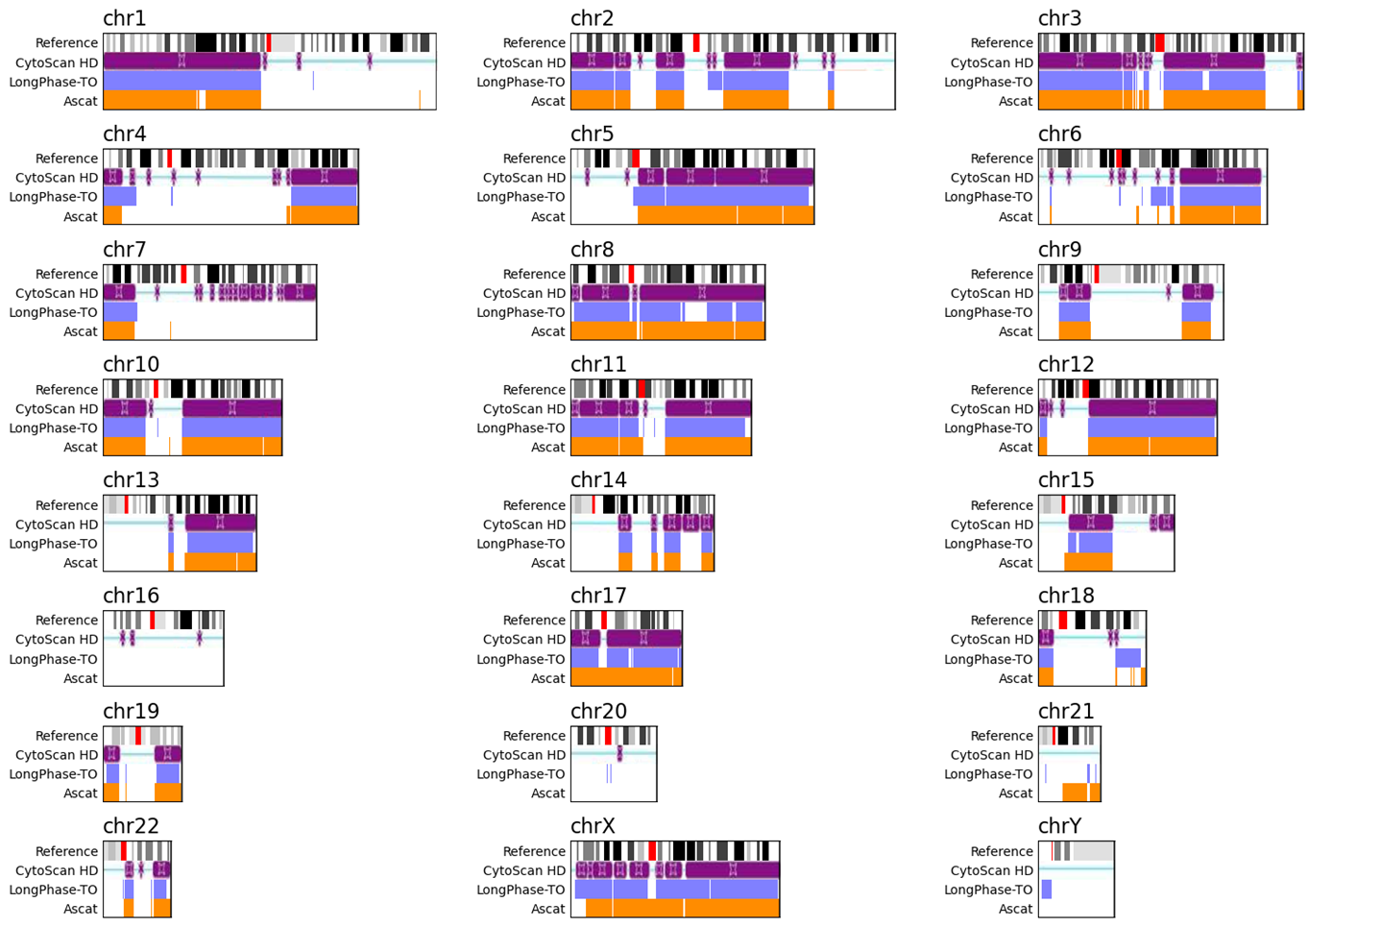
LongPhase-TO vs. Ascat

Slide 2
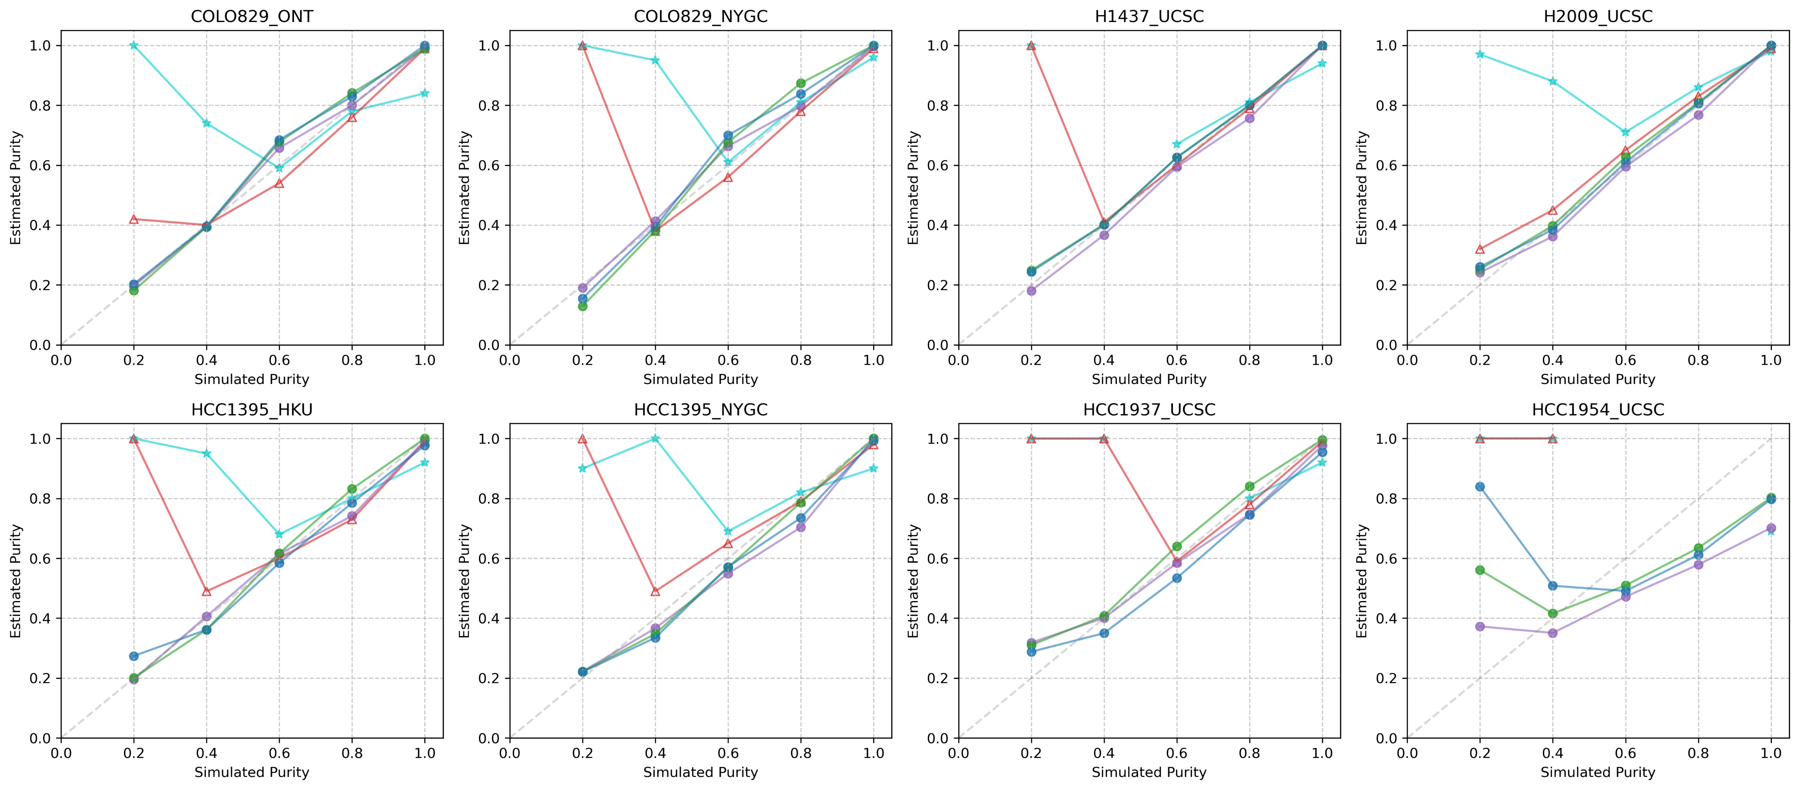
Purity Comparison

Slide 3
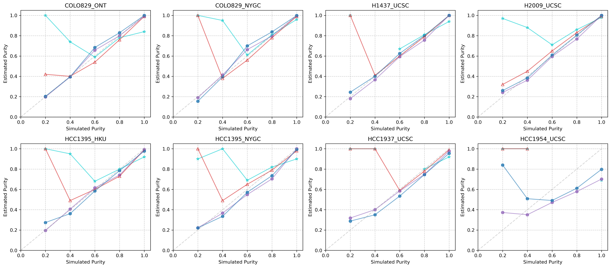
Purity Comparison

Slide 4
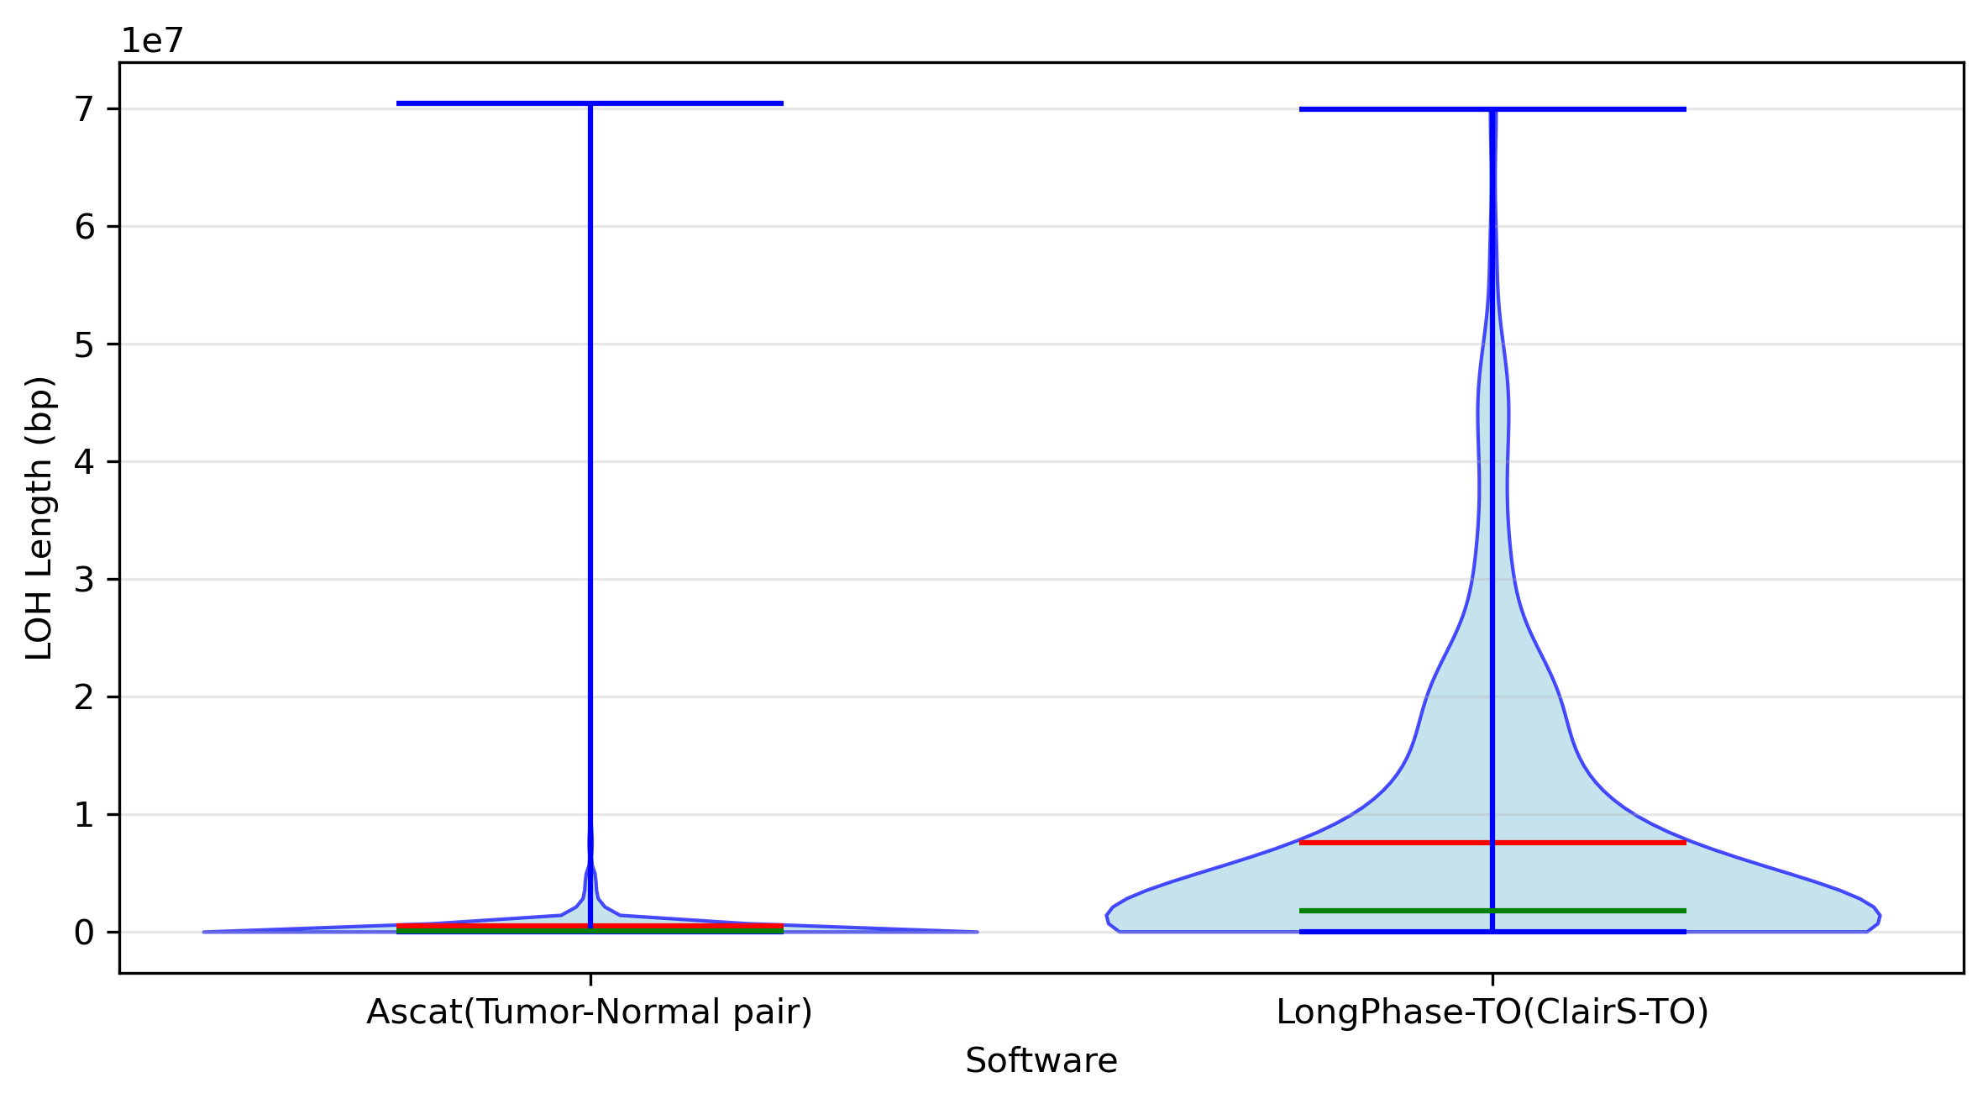
Performance Comparison
Software LOH_Ratio Blocks Sum(MB) N50(MB) Largest(MB)
LongPhase-TO(ClairS-TO) 0.4890 214 1613.404 21.280 69.878
Ascat(Tumor-Normal pair) 0.4964 3181 1637.669 3.185 70.416
Ascat(Tumor only) 0.5968 1402 1968.966 6.608 40.698
Distribution of LOH Lengths
Top 10 longest
Ascat
CHROM POS1 POS2 length
3180 X 85392896 155808494 70415598
517 10 81859837 107584746 25724909
3175 X 31655359 56547330 24891971
3177 X 57022657 79396313 22373656
3174 X 11306488 31251338 19944850
488 10 61372482 78256532 16884050
53 1 15140754 30080695 14939941
1061 17 151035 14554543 14403508
2558 5 167115616 181170660 14055044
2880 8 24623760 38374356 13750596
Longphase-TO
CHROM POS1 POS2 length
424 chr5 108041907 177920038 69878131
322 chr3 10000 57823644 57813644
268 chr2 113603480 162412477 48808997
404 chr4 140523510 189281888 48758378
41 chr1 72346156 117676489 45330333
67 chr10 88010560 132775235 44764675
467 chr6 122171274 166401250 44229976
584 chrX 63402359 103897540 40495181
363 chr3 129720971 169263282 39542311
421 chr5 71238242 107868809 36630567

Slide 5
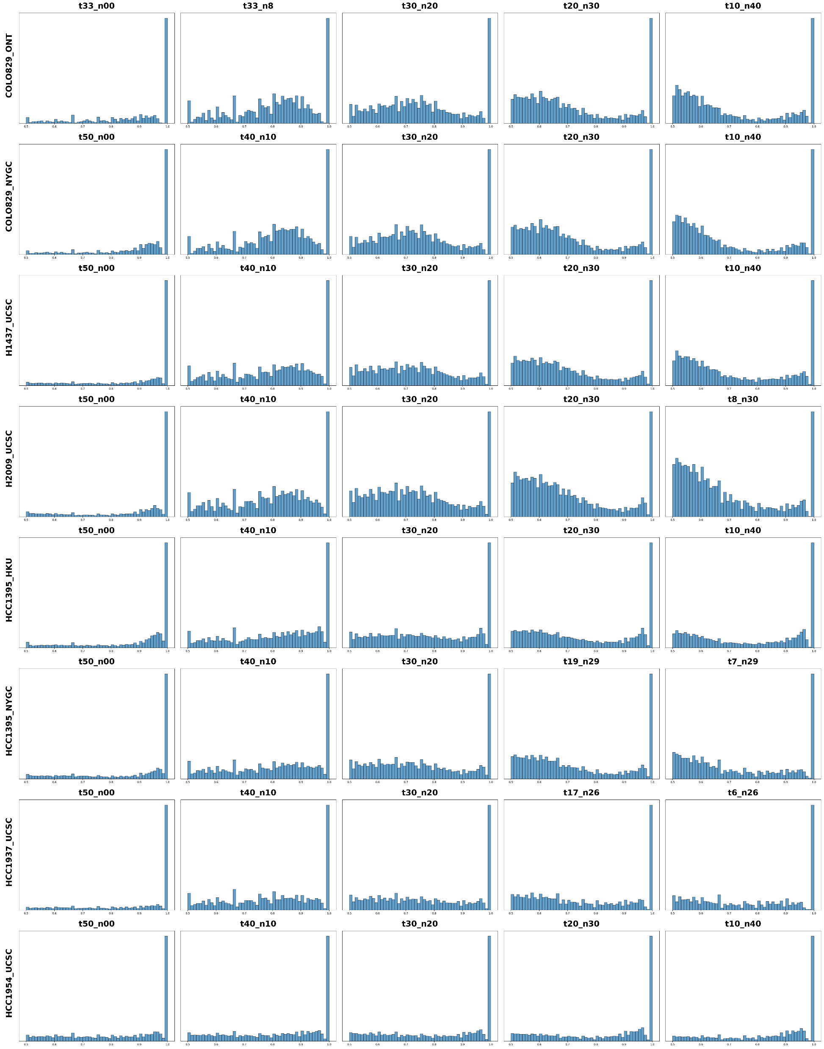
Distribution of haplotype imbalance across samples and purity levels

